Slide 1
Android Dice Rolling: A Java Project
Create a dice rolling app in Java for Android. Learn about random number generation and its significance in gaming development.
Name: Gautam Sachdeva
Roll no: 211092685

Slide 2
Introduction
Purpose of the Project
Designing the Dice Layout
01
02
Develop a mobile app that simulates rolling dice, providing an interactive experience for users.
Create a visually appealing layout with two dice images and a roll button. Utilize XML layout files for customization.
03
04
Implementing the Roll Button Functionality
Importance of Random Number Generation
Add event listeners and define actions for the roll button to generate random dice values upon click.
Learn how random numbers are crucial in games, ensuring fairness and unpredictability

Slide 3
Coding the Dice Rolling Logic
Defining the Random Number Generation Algorithm
Explore different algorithms, such as the Java Random class, to generate random numbers for each dice roll.
Assigning Random Values to Dice Faces
Map randomly generated numbers to specific dice face images, creating the illusion of rolling dice.

Slide 4
Testing and Debugging
Verified the Functionality of the Dice Roll
Thoroughly tested the app to ensure accurate and random results for each roll

Slide 5
Conclusion
Future Enhancements and Possibilities
Potential improvements, such as adding, rolling animation to dice, sound effects, multiplayer functionality.

Slide 6
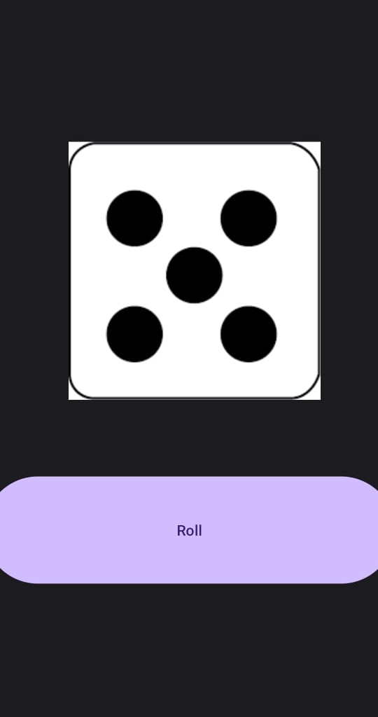
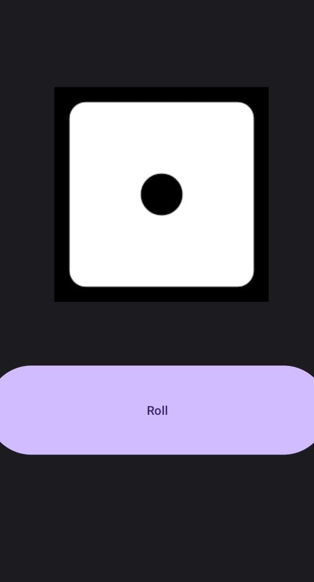
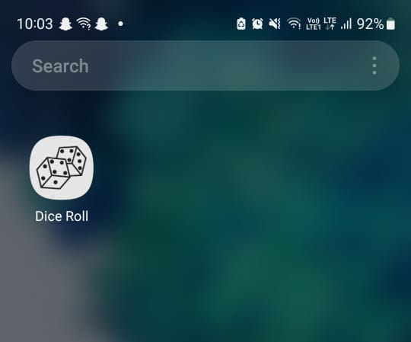
Screenshots

Slide 7
Thank You!

